Slide 1


APPLICATION OF ARTIFICIAL INTELIGENCE(AI) in TB mortality reduction in Homabay County Referral Hospital Homabay town, Homabay County among TB patients diagnosed in the facility 2023-2024
KCOA SCIENTIFIC CONFERENCE – LAKE NAIVASHA RESORT
15th OCTOBER 2025
Okal
:

Slide 2
Outline
Justification and Background
Study site
Objective
Methodology
Results
Conclusion/Recommendations
Acknowledgements

Slide 3
Justification
The study will improve patient management and Quality of Care by:
Sensitization of facility leadership on systemic gaps in TB diagnoses and benefits of AI in improvement of treatment outcomes.
Sensitization of all Health care Providers on use of AI by following use of TB mortality risk factors.

Slide 4
Background
Tuberculosis (TB) is a major public health challenge in Kenya
Homa Bay County has among the highest TB and HIV co-infection rates nationally at 53% ,2024
The targets set to by WHO End TB strategy include a reduction of TB deaths by 95% by 2035 with baseline of 2015 at less than 35%
Traditional care pathways struggle with timely identification of high-risk patients

Slide 5
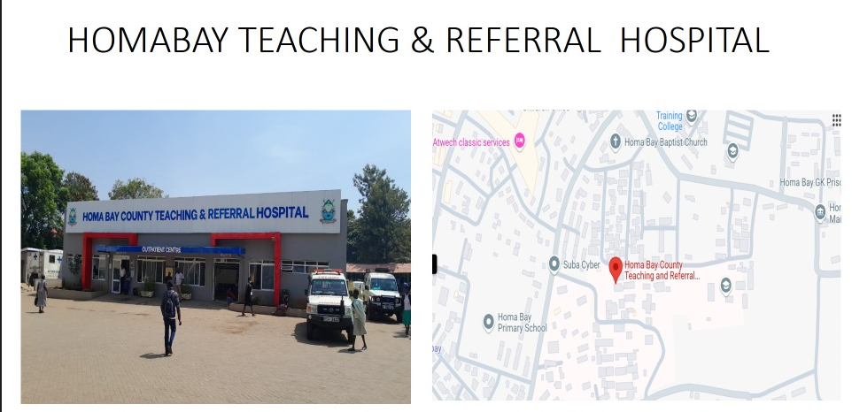
Study site
Homabay County Referral Hospital supported by county Government .-largest hospital in the western region in TB management
High TB burden facility-CNR 623/100000
Data availability –detailed patients records and electronic TB surveillance data which supports retrospective and prospective analysis
Diagnostic capacity that allows integration of AI powered tools into clinical workflows.
GK PRISON

Slide 6
Broad Objective
To assess the overall Role of AI in prediction of TB mortality risk and assist in improving TB outcomes in Health care settings mainly in HCRTH, Homabay Town Sub county, Homabay county .
Specific objectives
To characterized the risk factors attributes of TB patients diagnosed in 2023 to 2024
To describe the clinical manifestations, TB screening, diagnoses and outcomes among patients diagnosed before and after AI integration .

Slide 7
Problem Statement
Tuberculosis remains a leading cause of death due to delayed interventions of high risk TB patients despite integration of artificial intelligence into TB care that guides and support data driven decisions to reduce TB- related deaths .

Slide 8
Aim Statement
To Reduce tuberculosis mortality at Homabay County referral Hospital through the integration of artificial intelligence from a rate of 6% in 2022 to 2 % by end of 2024.

Slide 9
Methodology
A retrospective data review of 830 TB patients on follow-up from Jan 2023 to Dec 2024 in HCTRH , Homabay town Sub county.
Sociodemographic and clinical variables were abstracted from the TIBU ,TB5 and TB4
The clinical variables of interest were TB diagnosis ,HIV Status, Age sex, Treatment adherence , comorbidities, Lab results and BMI.

Slide 10
Methodology
AI Model-Machine learning algorithm , Data preprocessing and feature selection with risk score generation for each patient
The corresponding percentages were used to summarize categorical variables.
Data quality assessment was done using a Field Epidemiology and Laboratory Training Program standard tool and descriptive statistics.
• Performance Metrics:
Accuracy: 90%

Slide 11
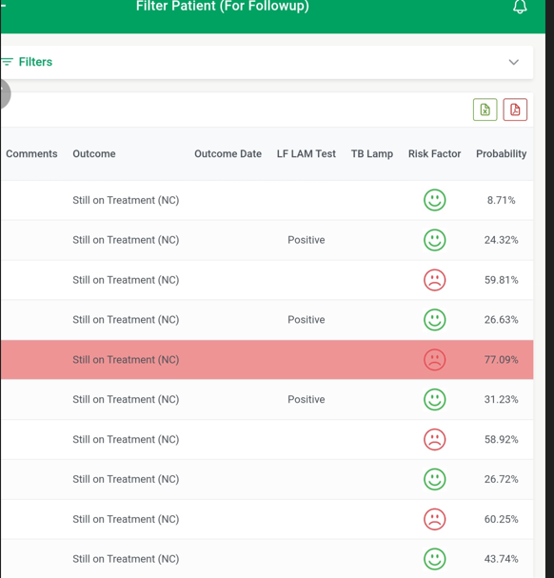
ARTIFICIAL INTELLIGENCE RISK PROBABILITY IN TIBU SURVEILLANCE

Slide 12
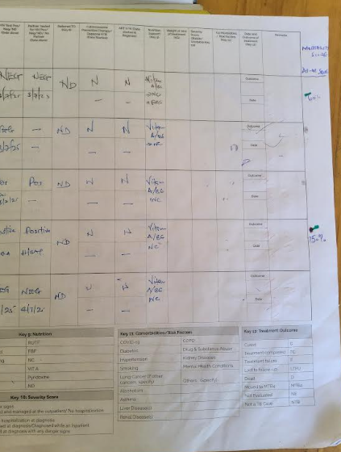
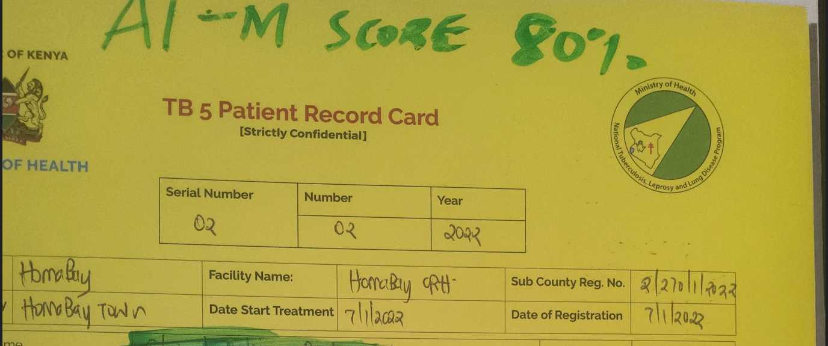
TB4 AND TB5 AI MORTALITY DOCUMENTATION

Slide 13
Socio demographic characteristics of TB clients attending TB clinic HBCTRH
2023-2024 (n=830)
Variable | Frequency | percentage
Sex Male Female | 480 350 | 57 43
Age Group <15 15-24 25-34 35-44 45-54 55-64 65+ | 27 40 330 250 95 45 45 | 3.2 4.8 39.7 30.1 11.4 5.4 5.4

Slide 14
Clinical characteristics of TB clients attending HBCTRH TB Clinic 2023-2024 n=830
Variable | Frequency | percentage
HIV status Neg Pos BMI >16 <18.5 <16 | 497 333 170 130 | 59.8 40.2 56 44
Lab results- bact confirmed Clinically | 426 404 | 51 49
Adherence to drugs -Yes -Non | 793 37 | 95.5 4.5
Comorbidities - yes no | 25 805 | 3 97

Slide 15
Results…..1
 | 2023 | 2024
Diagnosed with TB predicted to die in TIBU (covered al the mortality predictors) | 155 | 176
Diagnosed with TB that had outcome of death(BMI <16=15,HIV Pos=10,Lab result pos =5, combined 2 or more risks=25) | 25 | 8
of the 830 patient records reviewed, males accounted for 57% with a median age of 30 years; the TB mortality rate reduced by 32%(8/25) in 2024 compared to 2023

Slide 16
Results ……2
Key mortality predictors:
HIV co-infection-40.2%
Poor treatment adherence-4.5%
Low BMI-SAM-44%
Lab results –positive-51%
Comorbidities-3%
Implementation outcomes
32% reduction in TB-related deaths (2024 vs. 2023)
Improved clinical decision-making
Earlier intervention for high-risk cases

Slide 17
TB mortality trends before(2021-2022 )and During the AI intervention( 2023-2024)

Slide 18
Discussion
Male female ratio- more males affected
  Prevalence survey 2015-2016 and WHO TB report 2024,more males affected had similar reports
Similar mortality risk factors in previous Mortality TB audit report by- NTLP 2022
High index of evaluation is key among patients with such mortality risks to ensure quality of care outcomes
a study from Chengdu, china ICU data (2019-2022) pulmonary TB patients-mortality evaluation includes variables like BMI and comorbidities

Slide 19
Impact
Enhanced triaging and care prioritization
More efficient use of limited healthcare resources
Positive feedback from healthcare workers
Foundation for scaling AI tools in high burden conditions in health sector

Slide 20
Conclusion/Recommendations
AI can meaningfully support TB care in resource-limited settings.
Predictive modeling improves patient outcomes and supports public health strategy.
Expand use of AI-based decision support tools in TB and other chronic disease programs.

Slide 21
Acknowledgement
Homabay county government
Department of Health-Homabay county
HCTRH Administration and TB clinic
NTLP
TB TAMATISHA
KCOA

Slide 22
Thank you!!

